Slide 1
Questions
From R code
What are the selected feature?
What is the balanced dataset?
What are the KPIS, include accuracy, ROC…?
What are the significant features?
From python:
Do you have any difference with the different graph embeddings?
What are the KPIs of the different models?
Do the feature selection contributes to the model performance?
What are the significant features?

Slide 2
Ideas:
For python code-graph features:
Check the naïve accuracy for the test and training dataset? (imbalance dataset: )
Check the ROC calculation?
Add the cross validation?
2. For the R code:
We have to run the model on the features which includes the location feature

Slide 3
Tanguy
1. For the performance KPI: misclassification matrix, ROC, accuracy, cutoff value for determining the prediction (the optimal cutoff is 0.5954308 check )
For PK modeling:
Run all the methods on the 6 difference combinations. (Run the logistic regression on imbalanced data + all features)

Slide 4
FOR pk

Slide 5
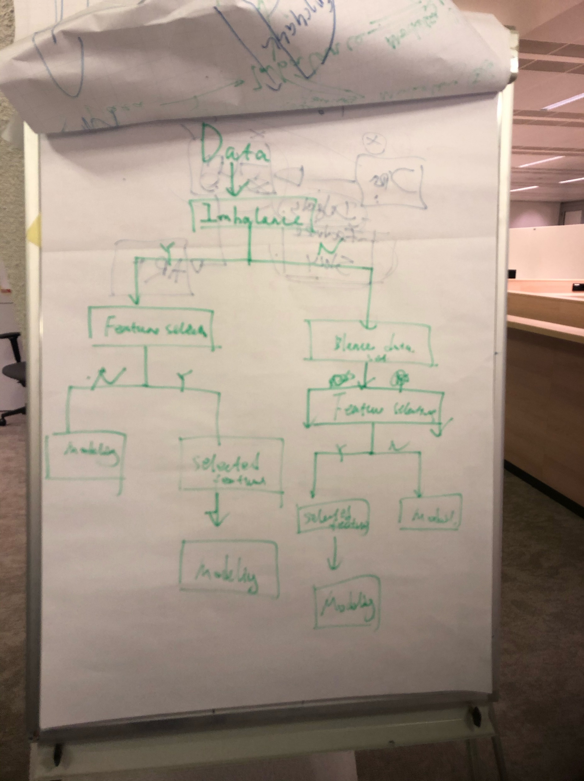
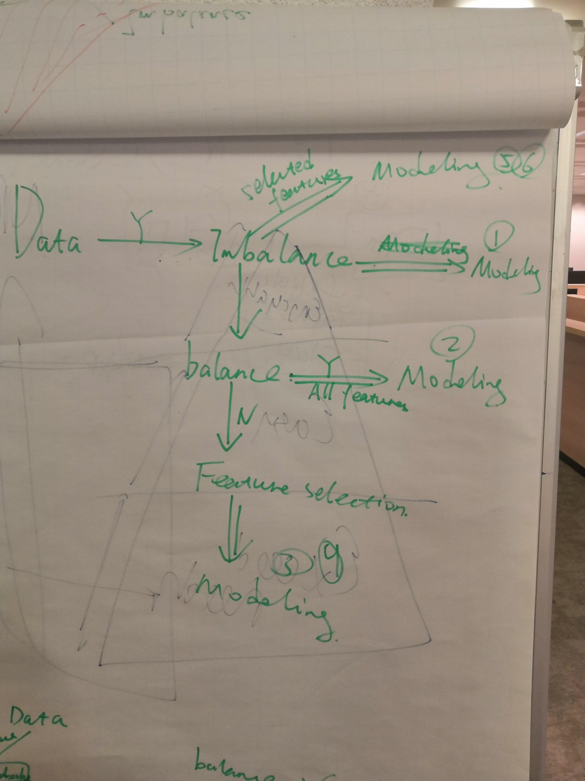

Slide 6
Modeling building workflow: in total should have 6 models
Done with topic_Loc_cust and pk
topic_Loc_cust pk | no feature selection Default cutoff | no feature selection Optimal cutoff | Random forest | boruta
balanced | Confusion matrix: [[1069 769] [ 463 662]] accuracy score: 0.5842051974350321 precision score: 0.46261355695317957 recall score: 0.5884444444444444 f1 score: 0.5179968701095461 the value of the AUC: 0.585027445290775 | Confusion matrix: [[ 32 1806] [ 3 1122]] accuracy score: 0.3894701316233547 precision score: 0.3831967213114754 recall score: 0.9973333333333333 f1 score: 0.5536639526276832 the value of the AUC: 0.5073717809212912 | Confusion matrix: [[1021 817] [ 418 707]] accuracy score: 0.5831927100911238 precision score: 0.46391076115485563 recall score: 0.6284444444444445 f1 score: 0.5337863344658361 the value of the AUC: 0.5919697739088381 | Confusion matrix: [[985 853] [396 729]] accuracy score: 0.5784677691528856 precision score: 0.4608091024020228 recall score: 0.648 f1 score: 0.5386036202438124 the value of the AUC: 0.5919542981501633
imbalanced | Confusion matrix: [[1761 77] [1040 85]] accuracy score: 0.6230172122848464 precision score: 0.5246913580246914 recall score: 0.07555555555555556 f1 score: 0.1320901320901321 the value of the AUC: 0.5168310966025873 | Confusion matrix: [[1329 509] [ 646 479]] accuracy score: 0.6101923725953425 precision score: 0.4848178137651822 recall score: 0.42577777777777776 f1 score: 0.45338381448177945 the value of the AUC: 0.5744231652762665 | Confusion matrix: [[1808 30] [1102 23]] accuracy score: 0.6179547755653054 precision score: 0.4339622641509434 recall score: 0.020444444444444446 f1 score: 0.039049235993208836 the value of the AUC: 0.5020611776085118 | Confusion matrix: [[1705 133] [1013 112]] accuracy score: 0.6132298346270671 precision score: 0.45714285714285713 recall score: 0.09955555555555555 f1 score: 0.16350364963503647 the value of the AUC: 0.5135971466569943

Slide 7
TopLocEmb pk | no feature selection Default cutoff | no feature selection Optimal cutoff | Random forest | boruta
balanced | Confusion matrix: [[1069 769] [ 463 662]] accuracy score: 0.5842051974350321 precision score: 0.46261355695317957 recall score: 0.5884444444444444 f1 score: 0.5179968701095461 the value of the AUC: 0.585027445290775 | Confusion matrix: [[ 32 1806] [ 3 1122]] accuracy score: 0.3894701316233547 precision score: 0.3831967213114754 recall score: 0.9973333333333333 f1 score: 0.5536639526276832 the value of the AUC: 0.5073717809212912 | Confusion matrix: [[1021 817] [ 418 707]] accuracy score: 0.5831927100911238 precision score: 0.46391076115485563 recall score: 0.6284444444444445 f1 score: 0.5337863344658361 the value of the AUC: 0.5919697739088381 | Confusion matrix: [[985 853] [396 729]] accuracy score: 0.5784677691528856 precision score: 0.4608091024020228 recall score: 0.648 f1 score: 0.5386036202438124 the value of the AUC: 0.5919542981501633
imbalanced | Confusion matrix: [[1762 76] [1040 85]] accuracy score: 0.6233547080661491 precision score: 0.5279503105590062 recall score: 0.07555555555555556 f1 score: 0.1321928460342146 the value of the AUC: 0.5171031314230443 | Confusion matrix: [[1328 510] [ 647 478]] accuracy score: 0.6095173810327371 precision score: 0.48380566801619435 recall score: 0.42488888888888887 f1 score: 0.4524372929484145 the value of the AUC: 0.573706686011365 | Confusion matrix: [[1808 30] [1102 23]] accuracy score: 0.6179547755653054 precision score: 0.4339622641509434 recall score: 0.020444444444444446 f1 score: 0.039049235993208836 the value of the AUC: 0.5020611776085118 | Confusion matrix: [[1705 133] [1013 112]] accuracy score: 0.6132298346270671 precision score: 0.45714285714285713 recall score: 0.09955555555555555 f1 score: 0.16350364963503647 the value of the AUC: 0.5135971466569943

Slide 8
provinceEmb pk | no feature selection Default cutoff | no feature selection Optimal cutoff | Random forest | boruta
balanced | Confusion matrix: [[1069 769] [ 463 662]] accuracy score: 0.5842051974350321 precision score: 0.46261355695317957 recall score: 0.5884444444444444 f1 score: 0.5179968701095461 the value of the AUC: 0.585027445290775 | Confusion matrix: [[ 32 1806] [ 3 1122]] accuracy score: 0.3894701316233547 precision score: 0.3831967213114754 recall score: 0.9973333333333333 f1 score: 0.5536639526276832 the value of the AUC: 0.5073717809212912 | Confusion matrix: [[1021 817] [ 418 707]] accuracy score: 0.5831927100911238 precision score: 0.46391076115485563 recall score: 0.6284444444444445 f1 score: 0.5337863344658361 the value of the AUC: 0.5919697739088381 | Confusion matrix: [[985 853] [396 729]] accuracy score: 0.5784677691528856 precision score: 0.4608091024020228 recall score: 0.648 f1 score: 0.5386036202438124 the value of the AUC: 0.5919542981501633
imbalanced | Confusion matrix: [[1761 77] [1040 85]] accuracy score: 0.6230172122848464 precision score: 0.5246913580246914 recall score: 0.07555555555555556 f1 score: 0.1320901320901321 the value of the AUC: 0.5168310966025873 | Confusion matrix: [[1328 510] [ 646 479]] accuracy score: 0.6098548768140398 precision score: 0.48432760364004046 recall score: 0.42577777777777776 f1 score: 0.4531693472090823 the value of the AUC: 0.5741511304558095 | Confusion matrix: [[1808 30] [1102 23]] accuracy score: 0.6179547755653054 precision score: 0.4339622641509434 recall score: 0.020444444444444446 f1 score: 0.039049235993208836 the value of the AUC: 0.5020611776085118 | Confusion matrix: [[1705 133] [1013 112]] accuracy score: 0.6132298346270671 precision score: 0.45714285714285713 recall score: 0.09955555555555555 f1 score: 0.16350364963503647 the value of the AUC: 0.5135971466569943

Slide 9
Logistic regression – imbalanced + all features
[1] "misclassification matrix with the optimal cutoff: "
fitted.results.test
0 1
0 1838 23
1 1098 40
$Accurancy
[1] 0.6262087
$Naive
0 1
0.6205402 0.3794598
$CutOff
6051
0.5954308
$auc_value
[1] 0.6138653

Slide 10
Logistic regression – balanced + all features
[1] "misclassification matrix with the default cutoff 0.5:"
fitted.results.test.normal 0 1
0 1039 446
1 822 692
$Accurancy
[1] 0.5771924
$Naive
0 1
0.6205402 0.3794598
$CutOff
6070
0.7710908
$auc_value
[1] 0.610237

Slide 11
Logistic regression – balanced + selected features –random forest ([1] "LEEFT" "INCOME_PARTTIME_LATEST_JOB" "PARTTIME_INCOME_TOT" [4] "COMMUNICATIONCHOICE" "TYPE_DLN_BIGGEST_JOB" )
[1] "misclassification matrix with the default cutoff 0.5:"
fitted.results.test.normal 0 1
0 967 359
1 894 779
$Accurancy
[1] 0.5821941
$Naive
0 1
0.6205402 0.3794598
$CutOff is not used
57
0.5600182
$auc_value
[1] 0.6231

Slide 12
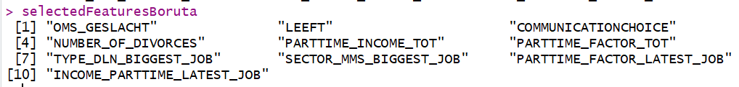
Logistic regression – balanced + selected features –boruta
[1] "misclassification matrix with the default cutoff 0.5:"
fitted.results.test.normal 0 1
0 1032 435
1 829 703
$Accurancy
[1] 0.5785262
$Naive
0 1
0.6205402 0.3794598
$CutOff
4728
0.7733609 is not used
$auc_value
[1] 0.6095198

Slide 13
Reference
Imbalance dataset
FOR DZ: 0.98385945 0.01614055
For PK: 0.6206256 0.3793744
Balance for pk:
0 1 0.502214 0.497786
FOR dz:
0 1 0.4917869 0.5082131

Slide 14
For PK, the select features
Random forest:
c("LEEFT", "INCOME_PARTTIME_LATEST_JOB", "PARTTIME_INCOME_TOT", "COMMUNICATIONCHOICE", "TYPE_DLN_BIGGEST_JOB")
2. Boruta#wrapper methodsselectedFeatures
Boruta=c("OMS_GESLACHT", "LEEFT", "COMMUNICATIONCHOICE", "NUMBER_OF_DIVORCES",
"PARTTIME_INCOME_TOT", "PARTTIME_FACTOR_TOT", "TYPE_DLN_BIGGEST_JOB",
"SECTOR_MMS_BIGGEST_JOB", "PARTTIME_FACTOR_LATEST_JOB", "INCOME_PARTTIME_LATEST_JOB"
)

Slide 15
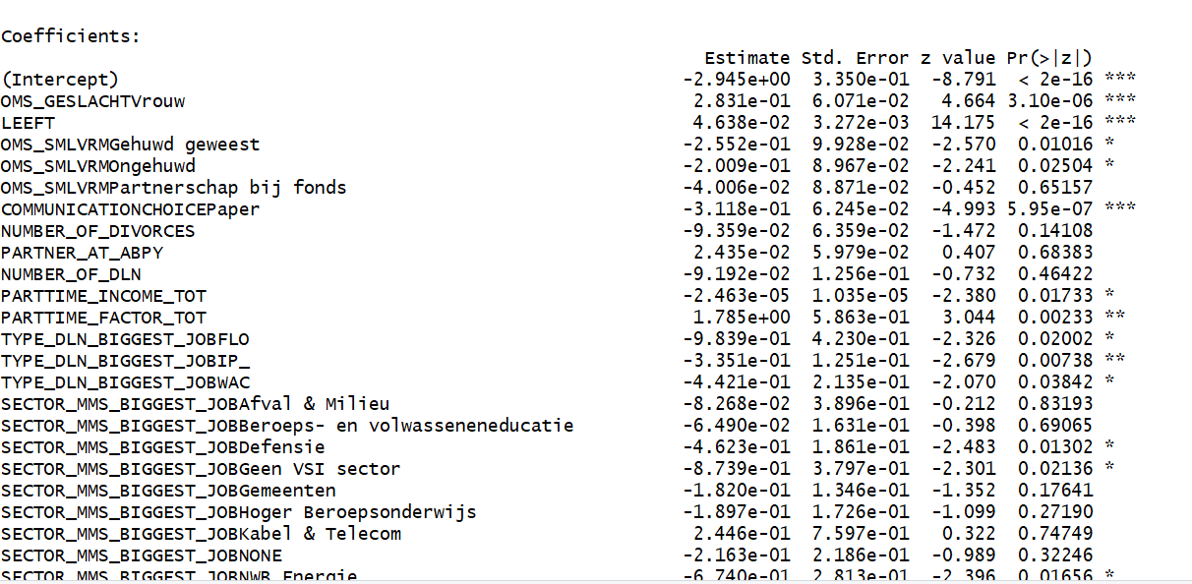
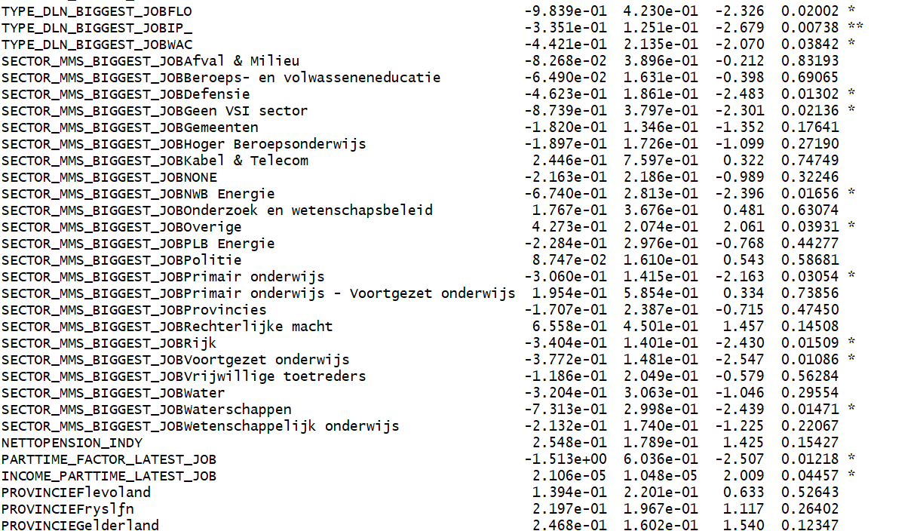
PK: Imbalance dataset

Slide 16
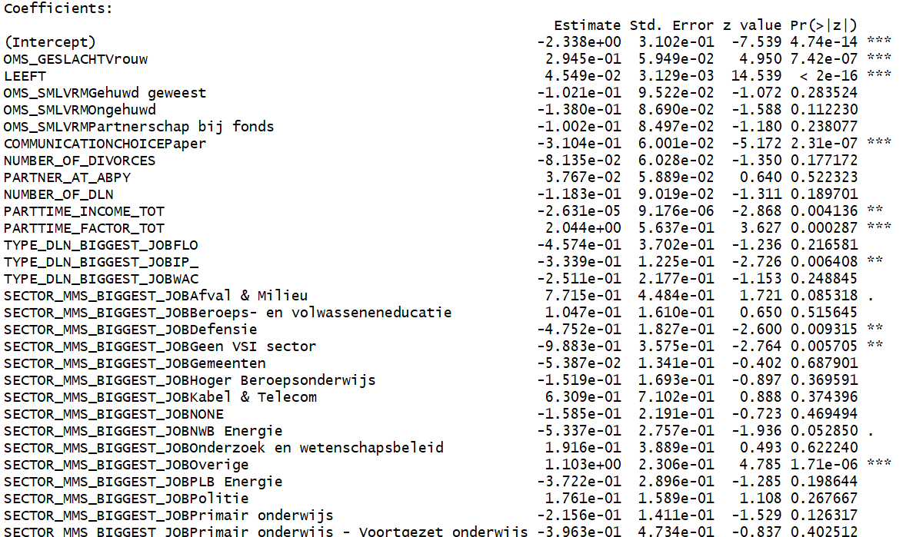
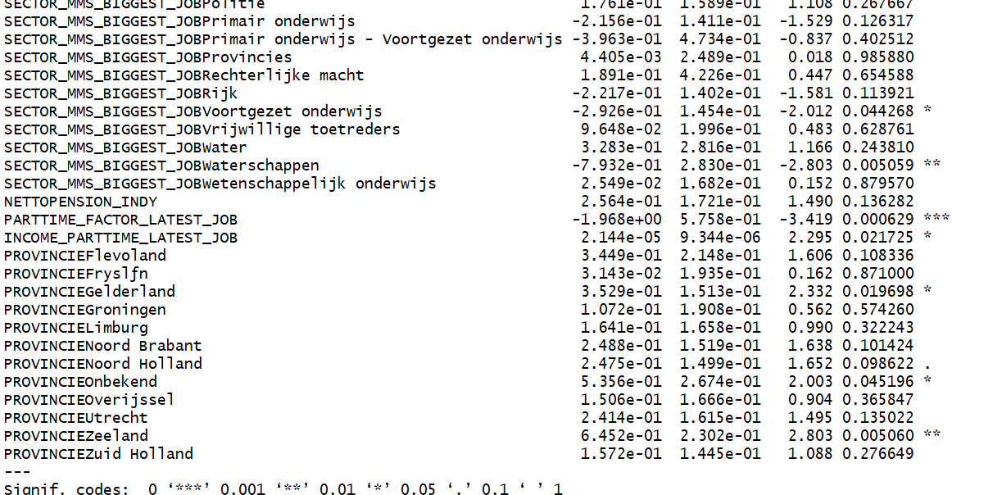
PK balance dataset

Slide 17
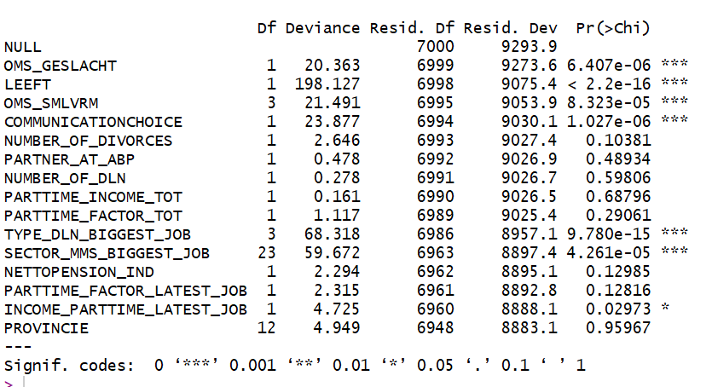
#The model performance against null model

Slide 18
FOR dz

Slide 19
For DZ, the select features
Random forest
c("LEEFT", "OMS_SMLVRM", "SECTOR_MMS_LATEST_JOB", "OMS_GESLACHT", "SECTOR_MMS_BIGGEST_JOB", "INCOME_PARTTIME_LATEST_JOB")
2. selectedFeaturesBorutaDZ=c("OMS_GESLACHT", "LEEFT", "NUMBER_OF_DIVORCES", "OMS_SMLVRM","NUMBER_OF_DLN",
"PARTTIME_INCOME_TOT", "PARTTIME_FACTOR_TOT", "TYPE_DLN_BIGGEST_JOB",
"NETTOPENSION_IND", "PARTTIME_FACTOR_LATEST_JOB", "INCOME_PARTTIME_LATEST_JOB")

